Slide 1
Adversarial Search
Chapter 6
Section 1 – 4

Slide 2
Outline
Optimal decisions
α-β pruning
Imperfect, real-time decisions

Slide 3
Games vs. search problems
"Unpredictable" opponent → specifying a move for every possible opponent reply
For Chess, average branching 35; and search 50 moves by each player
  Time limits (35^100) → unlikely to find goal, must approximate

Slide 4
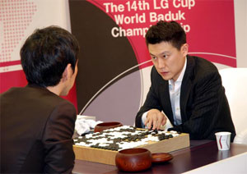
Two-Agent Games
Two-agent, perfect information, zero-sum games
Two agents move in turn until either one of them wins or the result is a draw.
Each player has a complete model of the environment and of its own and the other’s possible actions and their effects.

Slide 5
Minimax Procedure (1)
Two player : MAX and MIN
Task : find a “best” move for MAX
Assume that MAX moves first, and that the two players move alternately.
MAX node
  nodes at even-numbered depths correspond to positions in which it is MAX’s move next
MIN node
  nodes at odd-numbered depths correspond to positions in which it is MIN’s move next

Slide 6
Minimax Procedure (2)
Estimate of the best-first move
  apply a static evaluation function to the leaf nodes
  measure the “worth” of the leaf nodes.
  The measurement is based on various features thought to influence this worth.
  Usually, analyze game trees to adopt the convention
    game positions favorable to MAX cause the evaluation function to have a positive value
    positions favorable to MIN cause the evaluation function to have negative value
    Values near zero correspond to game positions not particularly favorable to either MAX or MIN.

Slide 7

Game tree (2-player, deterministic, turns)
tic-tac-toe

Slide 8

Minimax
Perfect play for deterministic games
Idea: choose move to position with highest minimax value
= best achievable payoff against best play
E.g., 2-ply game:

Slide 9

Minimax algorithm

Slide 10
Properties of minimax
Complete? Yes (if tree is finite)
Optimal? Yes (against an optimal opponent)
Time complexity? O(b^{m}) (b-legal moves; m- max tree depth)
Space complexity? O(bm) (depth-first exploration)
For chess, b ≈ 35, m ≈100 for "reasonable" games
→ exact solution completely infeasible

Slide 11
Example : Tic-Tac-Toe (1)
MAX marks crosses MIN marks circles
it is MAX’s turn to play first.
  With a depth bound of 2, conduct a breadth-first search
  evaluation function e(p) of a position p
    If p is not a winning for either player,
    e(p) = (no. of complete rows, columns, or diagonals that are still open for MAX) - (no. of complete rows, columns, or diagonals that are still open for MIN)
    If p is a win of MAX, e(p) = ∞
    If p is a win of MIN, e(p) = - ∞

Slide 12
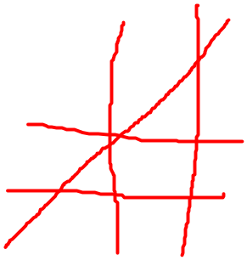
  evaluation function e(p) of a position p
    If p is not a winning for either player,
    e(p) = (no. of complete rows, columns, or diagonals that are still open for MAX) - (no. of complete rows, columns, or diagonals that are still open for MIN)
e(p)=5-4=1 e(p)=6-4=2

Slide 13
  evaluation function e(p) of a position p
    If p is not a winning for either player,
    e(p) = (no. of complete rows, columns, or diagonals that are still open for MAX) - (no. of complete rows, columns, or diagonals that are still open for MIN)
e(p)= e(p)=

Slide 14
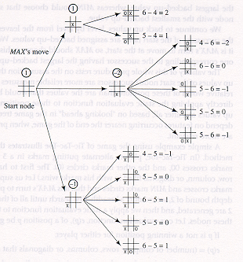
Example : Tic-Tac-Toe (2)
First move

Slide 15
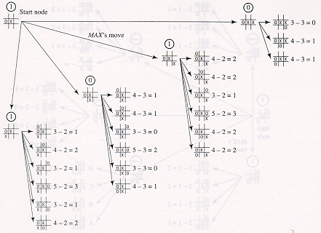
Example : Tic-Tac-Toe (3)

Slide 16
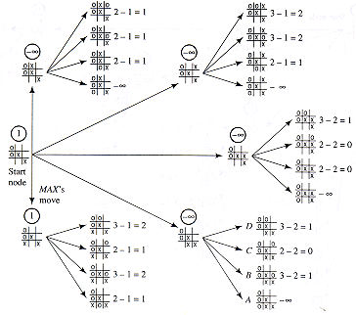
Example : Tic-Tac-Toe (4)

Slide 17
Question?
How to improve search efficiency?
It is possible to cut-off some unnecessary subtrees?

Slide 18

α-β Pruning Example

Slide 19

α-β pruning example

Slide 20

α-β pruning example

Slide 21

α-β pruning example

Slide 22

α-β pruning example

Slide 23
Properties of α-β
Pruning does not affect final result
Good move ordering improves effectiveness of pruning
With "perfect ordering," time complexity = O(b^{m/2})
  → doubles depth of search
A simple example of the value of reasoning about which computations are relevant (a form of metareasoning)

Slide 24



Why is it called α-β?
α is the value of the best (i.e., highest-value) choice found so far at any choice point along the path for max
If v is worse than α, max will avoid it
  → prune that branch
Define β similarly for min

Slide 25

The α-β algorithm

Slide 26

The α-β algorithm

Slide 27
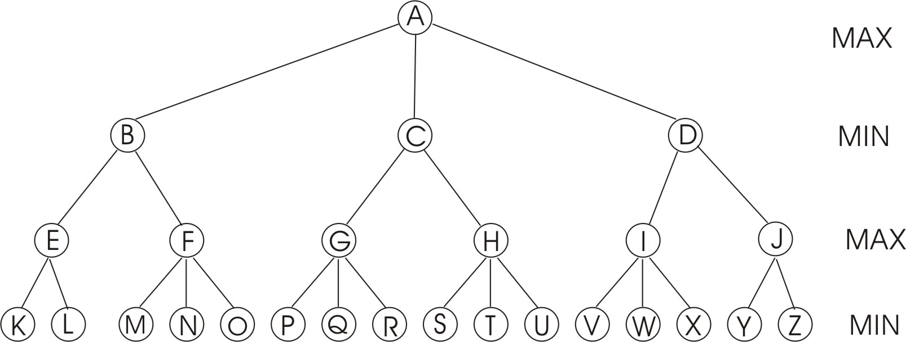
An Example
(a) Compute the backed-up values calculated by the minimax algorithm. Show your answer by writing values at the appropriate nodes in the above tree.
(b) Which nodes will not be examined by the alpha-beta procedure?
5 3 4 6 5 3 6 4 7 5 2 4 5 3 8 2

Slide 28
Resource limits
Suppose we have 100 secs, explore 10⁴ nodes/sec
→ 10⁶ nodes per move
Standard approach:
cutoff test:
  e.g., depth limit (perhaps add quiescence search)
evaluation function
  = estimated desirability of position

Slide 29
Evaluation functions
For chess, typically linear weighted sum of features
Eval(s) = w₁ f₁(s) + w₂ f₂(s) + … + w_{n} f_{n}(s)
e.g., w₁ = 9 with
f₁(s) = (number of white queens) – (number of black queens)
First, the evaluation function should order the terminal states in the same way as the true utility function;
Third, for nonterminal states, the evaluation function should be strongly correlated with the actual chances of winning.
Second, the computation must not take too long!

Slide 30
Cutting off search
MinimaxCutoff is identical to MinimaxValue except
  Terminal? is replaced by Cutoff?
  Utility is replaced by Eval
TERMINAL-TEST-->if CUTOFF-TEST(stated, depth) then return EVAL(state)
Does it work in practice?
b^{m} = 10⁶, b=35 → m=4
4-ply lookahead is a hopeless chess player!
  4-ply ≈ human novice
  8-ply ≈ typical PC, human master
  12-ply ≈ Deep Blue, Kasparov

Slide 31
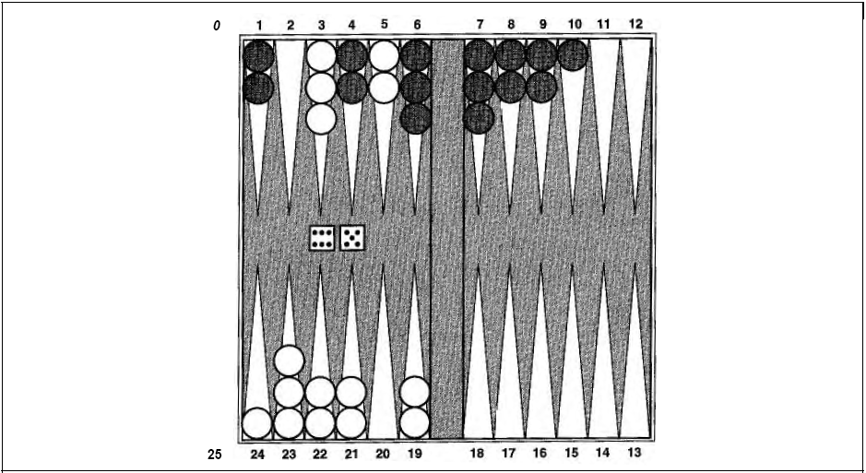
Game Include an Element of Chance
Backgammon

Slide 32
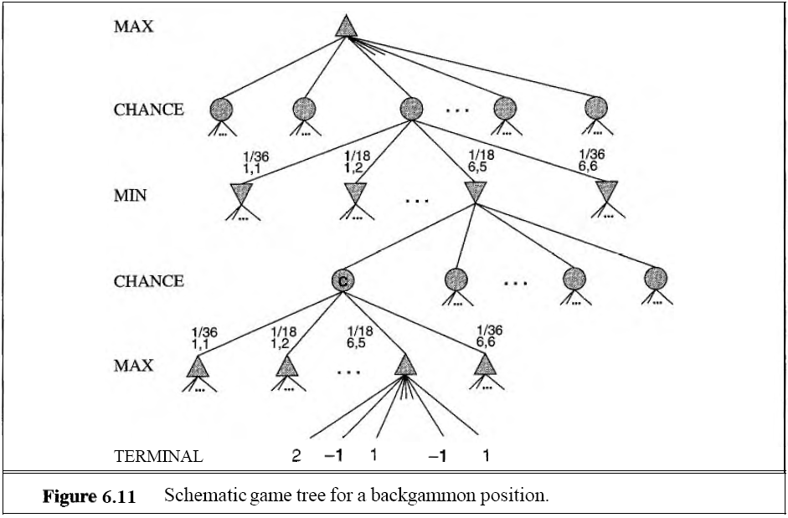
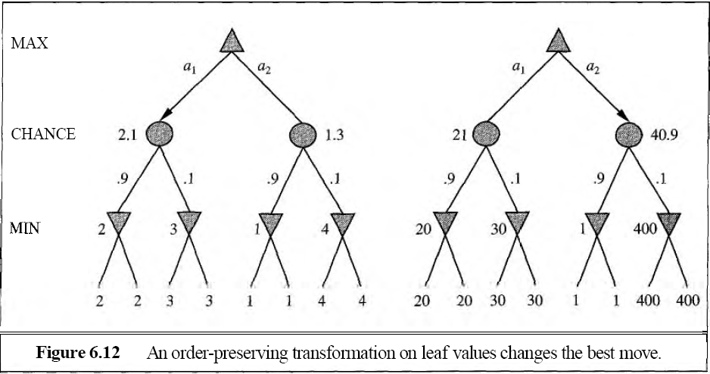
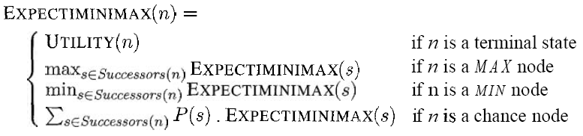
Game Include an Element of Chance

Slide 33
Deterministic games in practice
Checkers: Chinook ended 40-year-reign of human world champion Marion Tinsley in 1994. Used a precomputed endgame database defining perfect play for all positions involving 8 or fewer pieces on the board, a total of 444 billion positions.
Chess: Deep Blue defeated human world champion Garry Kasparov in a six-game match in 1997. Deep Blue searches 200 million positions per second, uses very sophisticated evaluation, and undisclosed methods for extending some lines of search up to 40 ply.
Othello: human champions refuse to compete against computers, who are too good.
Go: human champions refuse to compete against computers, who are too bad. In go, b > 300, so most programs use pattern knowledge bases to suggest plausible moves.

Slide 34
Summary
Games are fun to work on!
They illustrate several important points about AI
Perfection is unattainable → must approximate
Good idea to think about what to think about

